Slide 1
EE227 – Digital Logic Design
Lecture 1 – 3

Slide 2
Outline
Instructor’s Introduction
Course Outline
Marks Distribution
Information Processing
Analog and Digital Quantities
Advantages of Digital System
Number Systems
Base Conversions
Complements of Numbers

Slide 3
Contact Details
Email
waqar.baig@nu.edu.pk
Office:
Room Number , International Office
Visiting Hours:
Monday 2:00 PM – 3:00 PM
Friday 3:00 PM – 4:00 PM
Or by appointment

Slide 4
Books
Text Book
M. Morris Mano; Charles R. Kime, Logic and Computer Design Fundamentals Edition: (5 th Edition Updated, Prentice Hall)
Reference Book
John F. Wakerly, Digital Design: Principles and Practices (5 th Edition,Pearson Education, 2001)
Thomas L. Floyd, Digital Fundamentals (7th Edition, Prentice Hall, 2000)

Slide 5
Course Outline
Week | Topics | Chapter
1, 2 | Introduction, Number Systems (Binary, Octal and Hexadecimal), Number Ranges, Arithmetic Operations, Conversion from Decimal to Other Bases, Negative number representations | 1
3, 4, 5 | Binary Logic and Gates, Boolean Algebra, Standard Forms, Map Simplification, Map Manipulation, Don’t-Care Conditions, NAND, NOR & Exclusive-OR Gates & Circuits, Integrated Circuits, Positive & Negative Logic | 2, 3
6, 7, 8 | Combinational Circuits, Analysis Procedure, Design Procedure, Decoders, Encoders, Priority Encoders, Multiplexers, Demultiplexers, Binary Adders (Half, Full, Ripple Carry, Carry Lookahead), Binary Subtraction, Signed Binary Numbers, Overflow | 4
9, 10, 11 | Sequential Circuits, Latches, Flip-Flops, Sequential Circuit Analysis, State Diagram, Sequential Circuit Design (with D Flip-Flops, JK Flip-Flops, T flip flops), word problems | 5
12, 13, 14 | Registers and Counters, Register with Parallel Load, Shift Registers, Shift Register with Parallel Load, Bidirectional Shift Register, Ripple Counter, Synchronous Binary Counters, Serial and Parallel Counters, Up-Down Binary Counter, Binary Counter with Parallel Load. Miscellaneous Counters (BCD Counters, Arbitrary Sequence Counters) | 6
15, 16 | Memory and Programmable Logic Devices, Random-access Memory, Dynamic RAM ICs, Programmable Logic Technologies (Read-only Memory, Programmable Logic Arrays, Programmable Array Logic Devices, FPGAs) | 7

Slide 6
Marks Distribution
Mid Term I 15%
Mid Term II 15%
Quizzes 15%
Assignment/Project 10%
Final Exam 45%

Slide 7
Attendance Policy
In order to appear in final exam, 80% attendance is must, and there will be zero tolerance on attendance
Attendance will be called at the start of every class and you will be marked as absent if you are more than 10 minutes late
Only excuses obtained officially are accepted. Personal excuses are not accepted. No make-up tests/quizzes/exams will be provided until instructed by academic committee

Slide 8
General Guidelines
Some quizzes will be unannounced
The environment of class will be friendly but we have to respect the environment of the class
You are free to ask relevant questions during the lecture
Use of mobile phones/tablets/laptops in the class is strictly not allowed
Grading scheme will be decided according to class performance
Partially or fully copied assignments/reports will be marked as ZERO
There will be no extension in the deadlines

Slide 9
Now Lets Start the Course
☺

Slide 10
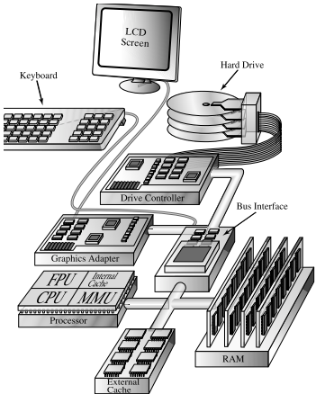
Generic Computer

Slide 11
Information Processing
In our daily life we have to process the following types of data
Text
Numbers
Formulas and Equation
Pictures
Audio
Video
All above can be divided in two categories
Analog
Digital

Slide 12
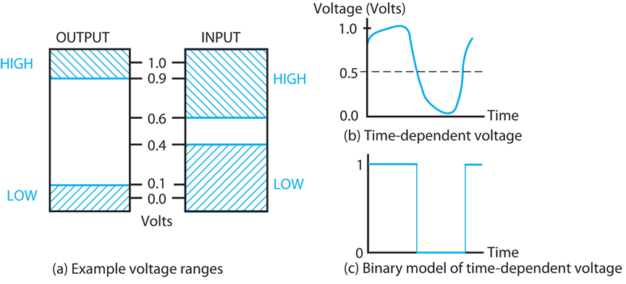
Information Representation (Cont.)
The signals in most present-day electronic digital systems use just two discrete values and are therefore said to be binary.
The two discrete values used are often called 0 and 1, the digits for the binary number system.
(Figure) Examples of Voltage Ranges and Waveforms for Binary Signals.

Slide 13
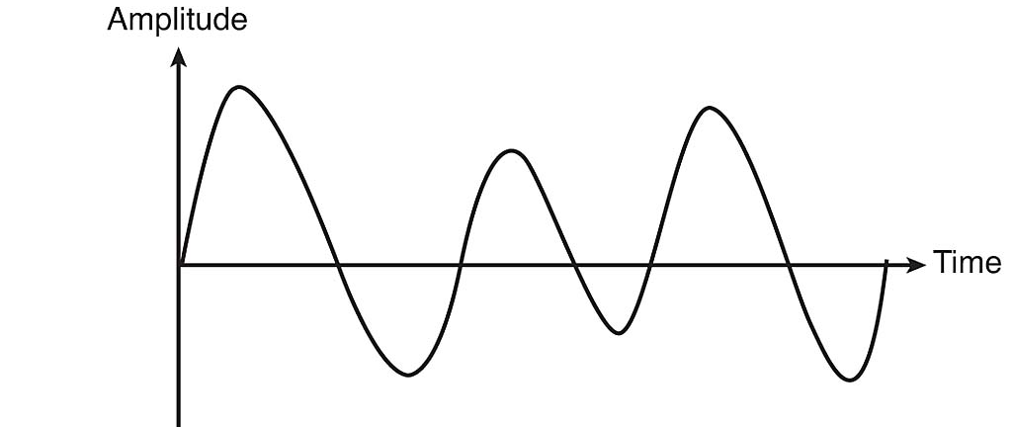
Analog Quantities
Continuous in nature
Intensity of light
Temperature
Velocity

Slide 14
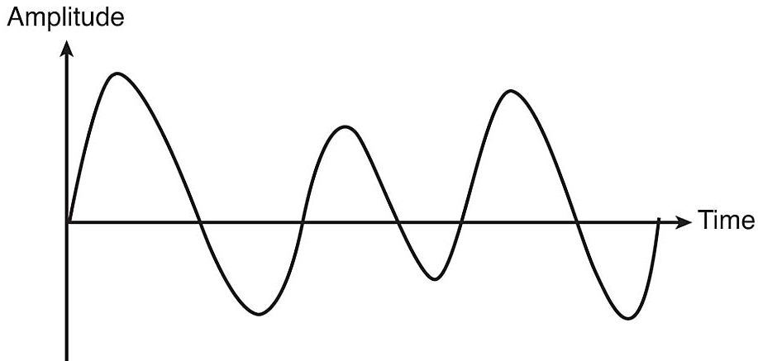
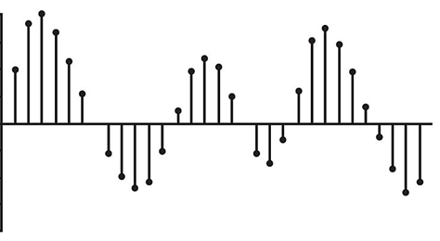
Digital Quantities
Discrete set of values
Can be obtained by sampling of analog signals

Slide 15
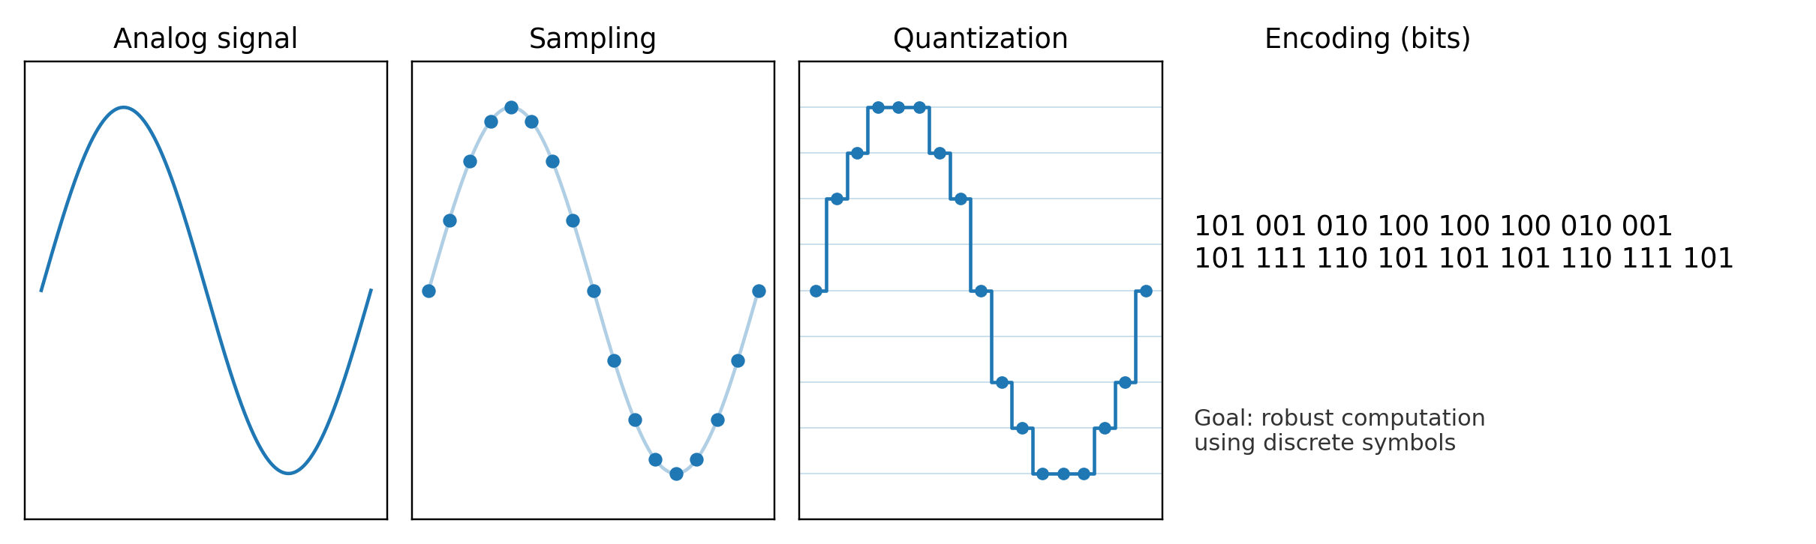
Analog → Digital: sampling and quantization
Sampling turns time into discrete points
Quantization maps amplitudes to levels
Encoding stores levels as bits

Slide 16
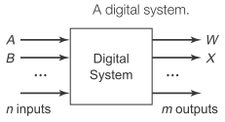
What is a digital system?
It is a system that manipulates (processes) discrete elements of information.
A digital system is a discrete information processing system.
Examples of digital systems:
the calculator,
digital voltmeters,
and general purpose computers.
In such systems, all quantities are represented using two values.
Note: if the system in Not Digital, it is "Analog".

Slide 17
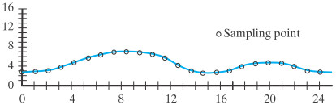
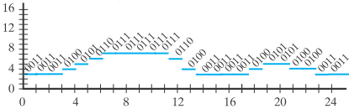
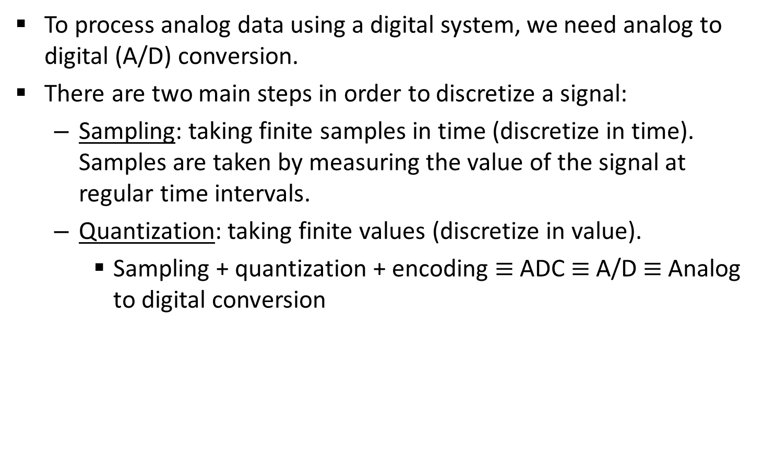
What is A/D conversion?
To process analog data using a digital system, we need analog to digital (A/D) conversion.
There are two main steps in order to discretize a signal:
Sampling: taking finite samples in time (discretize in time). Samples are taken by measuring the value of the signal at regular time intervals.
Quantization: taking finite values (discretize in value).
Sampling + quantization + encoding $≡$ ADC $≡$ A/D $≡$ Analog to digital conversion

Slide 18
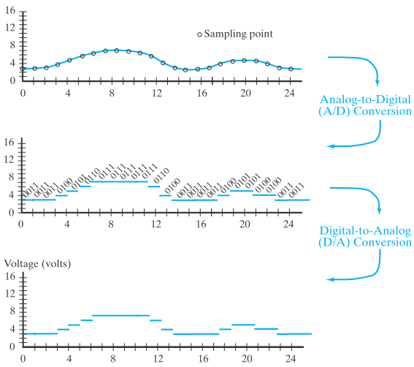
What is A/D conversion? (Cont.)

Slide 19
What is A/D conversion? (Cont.)
How many values to consider when quantizing data?
Multi-valued quantization.
Binary-valued quantization
Example: Comparison between multi-valued and binary-valued quantization assuming that the voltage range is 0-3.
Voltage | Multi-valued | Binary-valued
0-0.5 | 0 | 000
0.5-1 | 1 | 001 (encoding)
1-1.5 | 2 | 010
1.5-2 | 3 | 011
2-2.5 | 4 | 100
2.5-3 | 5 | 101
Sample value | Digital Multi-valued logic | Digital binary

Slide 20
What is A/D conversion? (Cont.)
Note that in order to transfer data in case of multi-valued quantization, we need fewer wires.
In this example, the multi-valued quantized data requires one wire whereas binary-valued quantized data requires three wires.
However, binary quantization is preferred over multi-valued quantization since it provides higher immunity to noise.
In general, binary systems are preferred since they are simpler, easy to design, and extremely reliable.
Note: Always keep in mind that digital does not mean binary.

Slide 21
A/D conversion in one picture
A/D is: sample → quantize → encode
More bits = higher resolution (cost/complexity tradeoff)

Slide 22
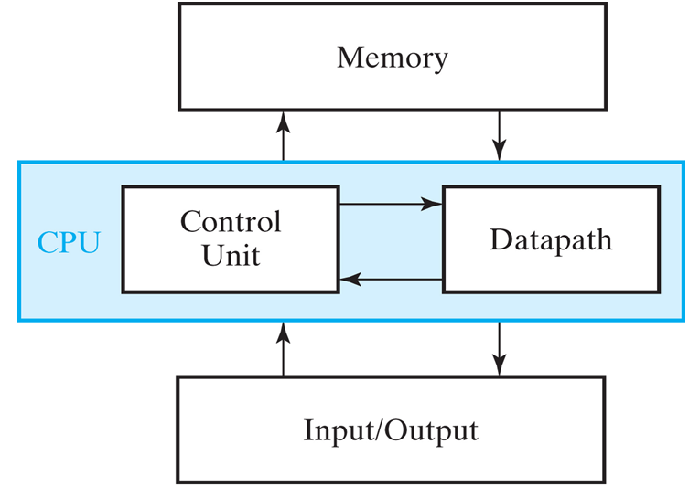
The Digital Computer
General-Purpose Computers are an example of binary systems.
A block diagram of a digital computer is shown in Figure below.

Slide 23
The Digital Computer
The memory stores programs as well as input, output, ….
The datapath (ALU) performs arithmetic and other data-processing operations as specified by the program.
The control unit supervises the flow of information between the various units.
A datapath, when combined with the control unit, forms a component referred to as a central processing unit, or CPU.
Input device: keyboard.
Output device: LCD (liquid crystal display).
These devices use digital logic circuits

Slide 24
Digital logic (Cont.)
Physical quantities: continuous.
Signal: mathematical function that describes physical quantities.
Digital signal: discrete in time and finite.
Analog signal: infinite values.
Again: why digital?
Analog has errors.
Digital systems have excellent noise immunity.
Most real life signals are analog signals (continuous)

Slide 25
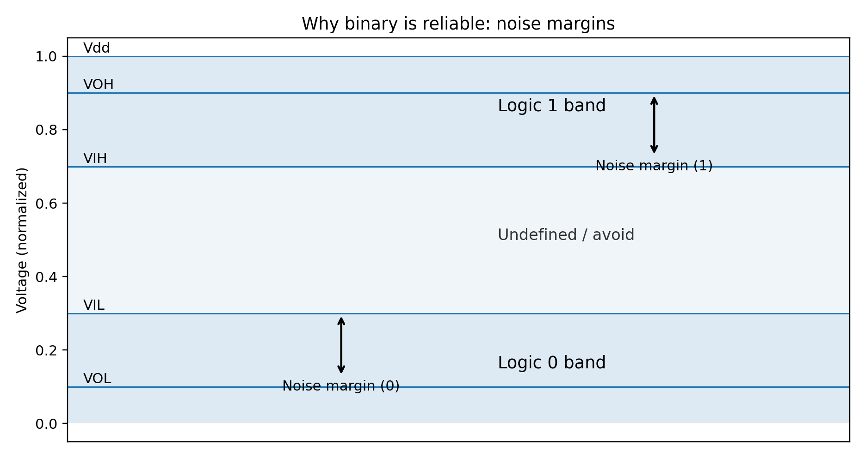
Why binary is reliable: noise margins
Binary works because it tolerates noise
Undefined region is where systems can fail
Noise margins define robustness

Slide 26
Why Digital Logic Design is Important?
A digital system is an interconnection of digital modules
To understand the operation of each digital module, it is necessary to have a basic knowledge of digital circuits and their logical function

Slide 27
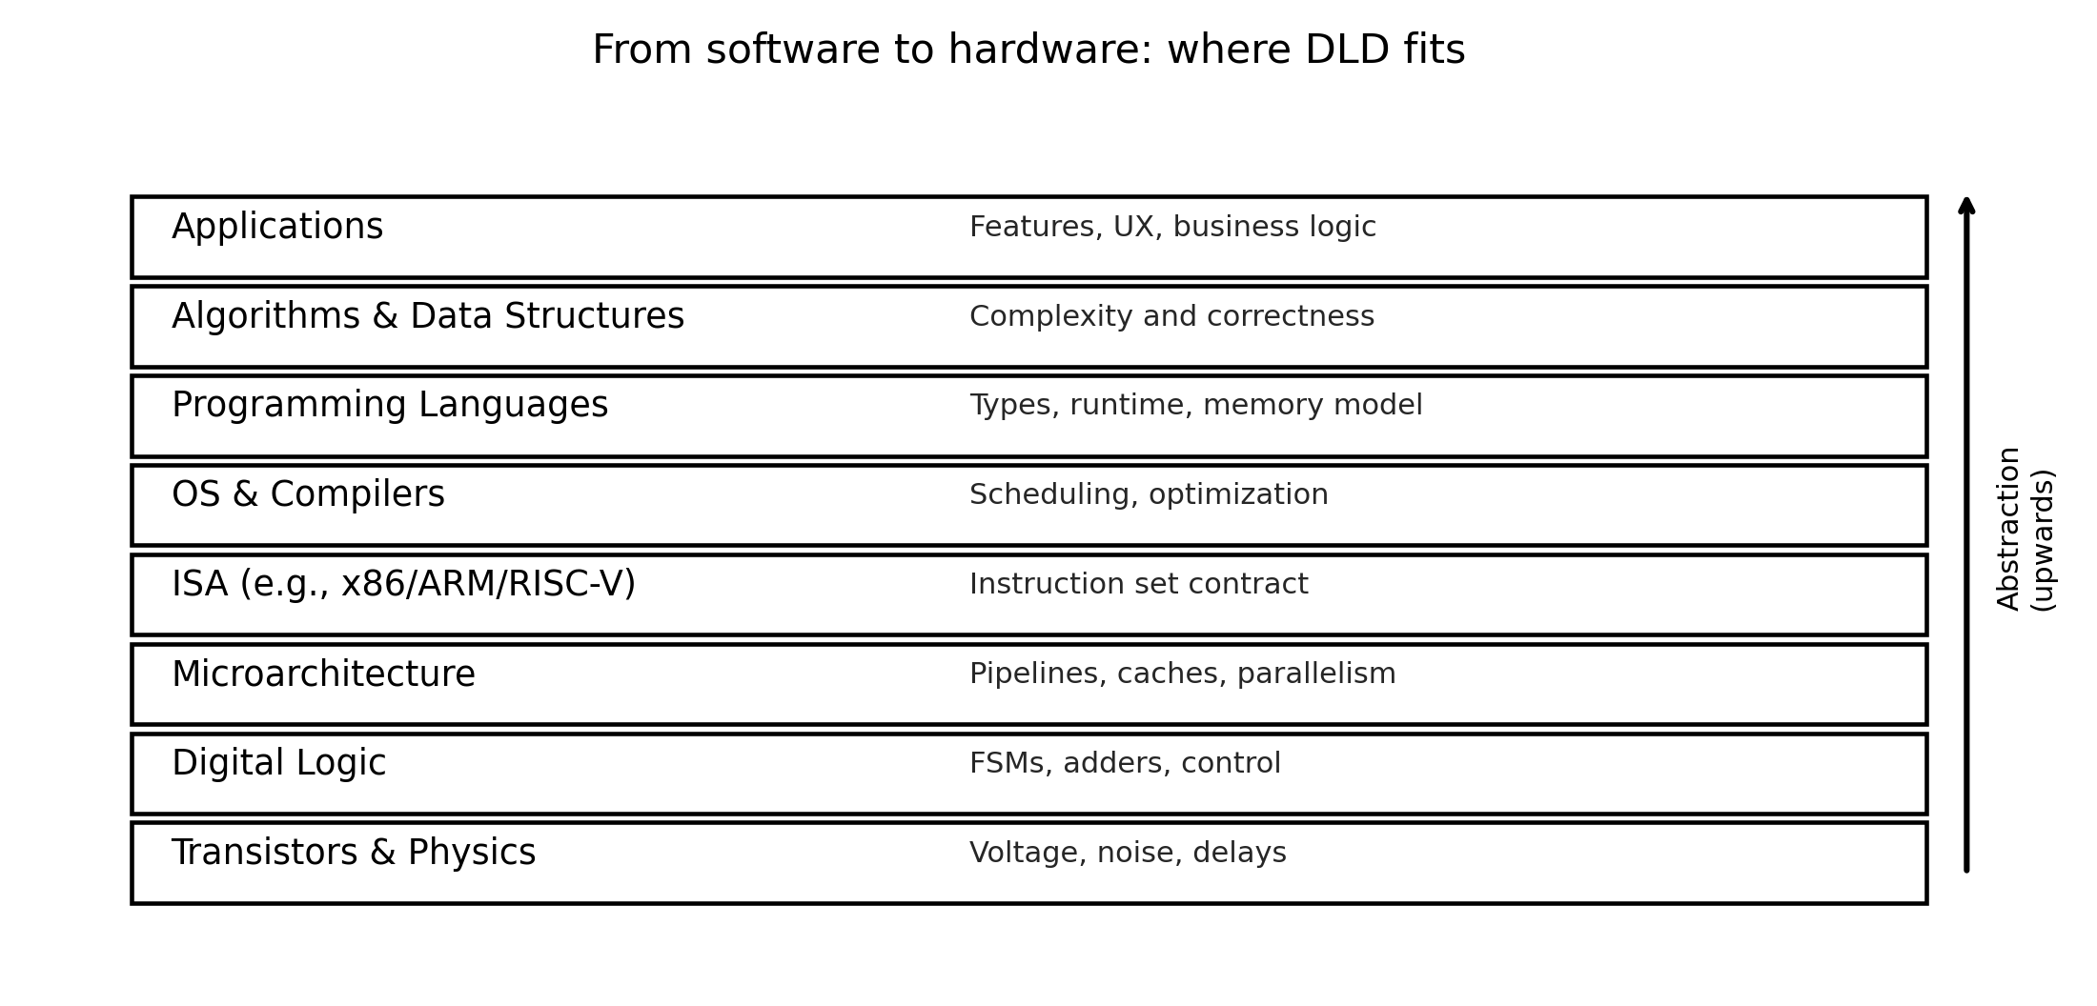
Where DLD fits in the computing stack
DLD links software abstractions to hardware reality
Performance, security, and energy all depend on this layer

Slide 28
Data Representation
Four basic data representation techniques
Binary (base 2)
Octal (base 8)
Decimal (base 10)
Hexadecimal (base 16)
System | Base | Possible Digits
Binary | 2 | 0 1
Octal | 8 | 0 1 2 3 4 5 6 7
Decimal | 10 | 0 1 2 3 4 5 6 7 8 9
Hexadecimal | 16 | 0 1 2 3 4 5 6 7 8 9 A B C D E F
For a valid representation the digits used must be less than the Base

Slide 29
Binary Number System (1/2)
Data is represented with two possible states
Digits 1 and 0 are used to represent
1 → True
0 → False
Numbers are stored as sequence of 1s and 0s
0 0 1 0 1 0 1 0 1 0 1 1 0 1 1 1
Leftmost bit is call Most Significant Bit (MSB)
Rightmost bit is called Least Significant Bit (LSB)
MSB
LSB

Slide 30
Binary Number System (2/2)
Each bit is either 0 or 1
The weight of each bit is the power of 2
Bit number starts from 0
And counting starts from LSB
Bits 1 1 1 1 1 1 1 1
Weight 2⁷ 2⁶ 2⁵ 2⁴ 2³ 2² 2¹ 2⁰
Weight 128 64 32 16 8 4 2 1

Slide 31
Signed and Unsigned Binary Numbers
Binary integers can be signed or unsigned
Signed integers, as evident from name, are either positive or negative
Unsigned integers are by default positive

Slide 32
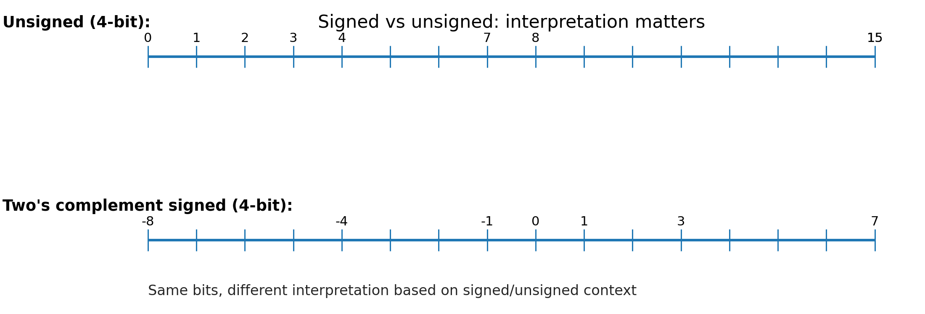
Signed vs unsigned: same bits, different meaning
Unsigned: 0 … 2^n − 1
Signed (two's complement): −2^(n−1) … 2^(n−1) − 1
Bugs happen when context is misunderstood

Slide 33
Hexadecimal Number System
Used to represent large binary numbers
Digits 0 to 15 are used in hexadecimal notation where 10 is A, 11 is B, 12 is C, 13 is D, 14 is E, and 15 is F
Commonly used to represent memory addresses
The weight of each digit is the power of 16

Slide 34
Decimal and Octal Number System
In decimal number system there are 10 possible digits (0 – 9)
The weight of each digit is the power of 10
For example (9874)₁₀ is a number in decimal number system
In Octal number system there are 8 digits (0 – 7 )
The weight of each digit is the power of 8
For example the number (7301)₈ is a number is octal system

Slide 35
Base Conversions
We will discuss the following base conversions during this course
Conversions of unsigned numbers
Conversions of fractions
Conversions of signed numbers

Slide 36
Unsigned Binary Integers to Decimal
Weighted Positional Notation method
D = binary digit
n = bit position number in binary number
Example
Convert 11010 to decimal
Convert 11001110 to decimal
Dec = (D_{n-1} x 2^{n-1}) + (D_{n-2} x 2^{n-2}) + . . . + (D₁ x 2¹) + (D₀ x 2⁰)

Slide 37
Decimal to Unsigned Binary Conversion
Repeatedly divide the decimal integer by 2 until the quotient is 0
The combination of remainders makes the binary number
The first remainder goes at LSB position and last remainder goes at MSB position
Example
Convert 25 from decimal to binary
Convert 115 from decimal to binary

Slide 38
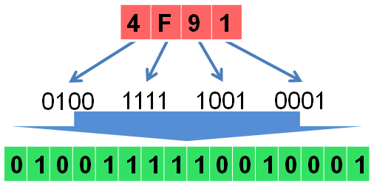
Hexadecimal to Binary
Each hexadecimal integer corresponds to 4 binary bits
Convert each hexadecimal number to corresponding binary number
Example
Convert 4F91 to binary

Slide 39
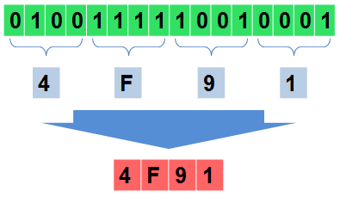
Binary to Hexadecimal
Starting from right convert each 4 bits of binary into its corresponding hexadecimal
If there are less than 4 bits remaining in the end then append zeros to complete the group of 4
Example
Convert 0100 1111 1001 0001 to hexadecimal

Slide 40
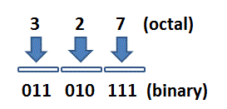
Octal to Binary
Each octal integer corresponds to 3 binary bits
Convert each octal number to corresponding binary number
Example
Convert 327 to binary

Slide 41
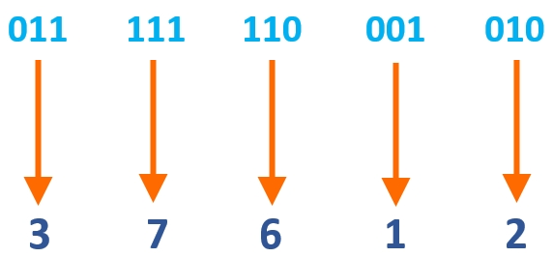
Binary to Octal
Starting from right convert each 3 bits of binary into its corresponding octal value
If there are less than 3 bits remaining in the end then append zeros to complete the group of 3
Example
Convert 11 111 110 001 010 to Octal

Slide 42
Hexadecimal to Decimal
Multiply each hexadecimal digit with its corresponding power of 16
D = hexadecimal digit
n = digit position number in hexadecimal number
Example
Convert 3BA4 to decimal
Convert 23AB to decimal
Dec = (D_{n-1} x 16^{n-1}) + (D_{n-2} x 16^{n-2}) + . . . + (D₁ x 16¹) + (D₀ x 16⁰)

Slide 43
Decimal to Hexadecimal
Repeatedly divide the decimal integer by 16 until last quotient is 0
Each remainder is a hex digit
First remainder goes at least significant position and last remainder goes at most significant position
Example
Convert 140 to Hexadecimal
Convert 396 to Hexadecimal

Slide 44
Practice Problem 1
Convert the following numbers to decimal
(123)₄
(32401)₅
(1100101)₂
Convert the following decimals numbers to indicated bases
(1254)₁₀ to base 3
(4096)₁₀ to base 16
(0362)₁₀ to base 8
Convert (2376)₈ to hexadecimal equivalent

Slide 45
Converting Fractions to Decimal
In any number system the base is also called the radix, and is represented by r
We can convert the fractions from any base to decimal by using the following relation
Example
Convert the following numbers to equivalent decimal numbers
(11010.11)₂
(4021.2)₅
(127.4)₈
Dec = (a_{n} x r^{n} + a_{n-1} x r^{n-1} + … + a₁ x r¹ + a₀ x r⁰) . (a₋₁ x r⁻¹ + a₋₂ x r⁻² + ….)

Slide 46
Converting Fractions from Decimal to Other Bases
Multiply the fractional part by radix (r), the integer part will be the first digit
Take the fractional part of the immediate product and multiply it by r again and note the next digit
Continue this process until the fractional part of the subsequent product is 0 or starts to repeat itself
For example lets convert 0.5625 to binary
The answer is (0.1001)₂
If there is an integer part then convert it separately by using the division technique

Slide 47
Practice Problem 2
Carry out the following conversions
0.513 to Octal
41.6875 to binary
(10010.100101)₂ to decimal
153.125 to octal
(10110001101011 . 11110000011)₂ to Octal
(306.D)₁₆ to binary
(673.124)₈ to binary
(10110001101011 . 1111001)₂ to Hexadecimal

Slide 48
Binary Arithmetic
Binary Addition
Binary Subtraction
Binary Multiplication
Binary Division
Notes:
We have looked at binary to decimal conversions and decimal to binary conversions.
Now we know how to convert integers as well as fractions from one number system to the other.
Now lets look at simple arithmetic operations such as add, subtract, multiply and divide.
We should be able to perform simple arithmetic operations such as add, subtract, multiply and divide on binary numbers, as we normally do with decimal numbers.
Arithmetic operations performed on binary numbers are in fact exactly like the operations performed on decimal numbers.
Let us start by looking at the binary addition operation

Slide 49
Binary Addition
Four Basic rules for binary addition
1st digit | 2nd digit | Sum | Carry
0 | 0 | 0 | 0
0 | 1 | 1 | 0
1 | 0 | 1 | 0
1 | 1 | 0 | 1
Addition of multiple binary numbers
Notes:
Looking at the results the first three additions give a result 0, 1 and 1 respectively which can be represented by a single binary digit (bit).
The fourth addition results in the number 2, which is represented in binary as 10₂.
Thus two digits (bits) are required. The sum bit is 0 and the carry bit is 1.
This is similar to the addition of 9 + 3 in decimal. The answer is 12 which can not be represented by a single digit, thus two digits are required. The number 2 is the sum part and 1 is the carry part.

Slide 50
Binary Addition
Carry |  | 1 | 10 | 1
1st Number |  | 1 | 0 | 1 | 1
2nd Number |  |  | 1 | 1 | 0
3rd Number |  | 1 | 0 | 0 | 0
4th Number |  |  |  | 1 | 1
Result | 1 | 1 | 1 | 0 | 0
Notes:
Similar to Decimal addition any number of binary numbers having any number of digits can be added together.
Thus the number 1011, 110, 1000 and 11 can be added together. Most significant digits (bits) of second and fourth numbers are assumed to be zero.
At Bit 2 the carry is 10, is it possible to have a 2-bit carry?
Consider adding the number 19, fifteen times.
Adding the first digit 9, fifteen times results in 135. 5 is the Sum and 13 is the carry.
The carry 13 added with fifteen 1s of the second digit result in 28.
The answer is 285.

Slide 51
Binary Subtraction
Four Basic rules for binary subtraction
1st digit | 2nd digit | Difference | Borrow
0 | 0 | 0 | 0
0 | 1 | 1 | 1
1 | 0 | 1 | 0
1 | 1 | 0 | 0
Notes:
The 2nd digit is subtracted from the first.
The result of the first, third and fourth subtraction operations result in a difference value where no borrow is required.
The second subtraction subtracts 1 from 0 for which a borrow is required to make the first digit equal to 2. The answer is 1.
This is similar to what is done in decimal 21-17 where 7 can not be subtracted from 1 therefore a 1 is borrowed from the next most significant digit to allow 7 to be subtracted from 11.
Thus if only the least significant digit of the decimal numbers is considered subtracting 7 from 1 results in a borrow of 1 and a difference of 4.

Slide 52
Binary Subtraction
Borrow |  |  | 1
1st Number |  | 1 | 0 | 1 | 1
2nd Number |  |  | 1 | 1 | 0
Result |  |  | 1 | 0 | 1

Slide 53
Binary Multiplication
Four Basic rules for binary multiplication
1st digit | 2nd digit | Product
0 | 0 | 0
0 | 1 | 0
1 | 0 | 0
1 | 1 | 1
Example of Binary Multiplication
Notes:
In binary multiplication anything multiplied by 0 results in 0 just like in decimal multiplication.

Slide 54
Binary Multiplication
1101 (13)
x 101 (5)
1st product term 1101
2nd product term 0000
3rd product term 1101
Product 1000001 (65)
Notes:
Binary multiplication is identical to the decimal multiplication.
The first product term results in 1101
The second product term results in 0000 and is written shifted left by 1 bit
The third product term results in 1101 and is written shifted left by 2 bits
The product result is sum of all the partial product terms

Slide 55
Multiplication by shifting left
Decimal 29 shifted left by one digit
290
Shift left 1 digit is multiply by 10
Binary 11101₂ (29) shifted left by one bit
111010₂ (58)
Shift left 1 bit is multiply by 2
Notes:
Multiplication operations can be performed by shifting a number towards left.
For example decimal 29 shifted left by 1 digit is like multiplying by 10
Shifting 29 by two digits towards left is multiplying by 10² or 100
Each shift left operation in decimal is equivalent to multiplying a number by 10.
In a binary number system, each left shift is equivalent to multiplying by 2.
Shifting 11101₂ twice towards left is 1110100₂ which is multiply by 4.

Slide 56
Binary Division
10
101 | 1101
101
011
000
11
Notes:
Binary division follows the same rules as in decimal division.
The binary division divides 1101₂ (13) by 101₂ (5) which results in a quotient value of 10₂ (2) and a remainder 11₂ (3) which is in confirmation with equivalent decimal division.

Slide 57
Division by shifting right
Decimal 29 shifted right by one digit
2.9
Shift left 1 digit is divide by 10
Binary 11101₂ (29) shifted left by one bit
1110.1₂ (14.5)
Shift left 1 bit is divide by 2
Notes:
Division operations can be performed by shifting a number towards right.
For example decimal 29 shifted right by 1 digit is like dividing by 10
Shifting 29 by two digits towards right is dividing by 10² or 100
Each shift right operation in decimal is equivalent to dividing a number by 10.
In a binary number system, each right shift is equivalent to dividing by 2.
Shifting 11101₂ twice towards right is 111.01₂ which is divide by 4.

Slide 58
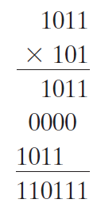
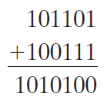
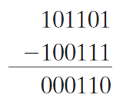
Binary Addition, Subtraction and Multiplication
Arithmetic operations with numbers in base r follow the same rules as for decimal numbers. When a base other than the familiar base 10 is used, one must be careful to use only the r‐allowable digits
Examples of addition, subtraction and multiplication in binary are given below

Slide 59
Signed Integers
Signed integers are either positive or negative
Not possible to stick negative sign to a number in binary numbers
When explicitly mentioned as signed integer, then MSB decides the +ve and –ve sign
In signed binary/octal/hex integers
MSB = 1 → integers is negative
MSB = 0 → integers is positive
Negative integers are represented using 2’s complement notation

Slide 60
Complements of Numbers
Complements are used in digital computers to simplify the subtraction operation and for logical manipulation
Simplifying operations leads to simpler, less expensive circuits to implement the operations
There are two types of complements for each base‐r system
Radix complement (r’s complement)
Diminished radix complement (r – 1’s complement)

Slide 61
Diminished Radix Complement
Given a number N in base r having n digits, the (r - 1)’s complement of N , i.e., its diminished radix complement, is defined as (r^{n} - 1) – N
Which means, subtract each digit of the number from (r – 1)
For example the diminished radix complement of 546700 is calculated as
999999 – 546700 = 453299
In case of binary numbers it is called 1’s complement and is obtained by inverting all the bits
For example the 1’s complement of 11001 is 00110

Slide 62
Radix Complement
Radix complement is computed by adding 1 to the diminished radix complement
For example the r’s complement of 546700 is calculated as
999999 – 546700 = 453299 + 1 = 453300
In case of binary numbers it is called 2’s complement and can be calculated in two ways
Adding 1 to 1’s complement
By leaving all least significant 0’s and the first 1 unchanged and replacing 1’s with 0’s and 0’s with 1’s in all other higher significant digits
For example the 2’s complement of 1101100 is 0010100

Slide 63
Complements of Fractions
In the previous definitions, it was assumed that the numbers did not have a radix point
If the original number N contains a radix point, the point should be removed temporarily in order to form the r’s or (r - 1)’s complement
The radix point is then restored to the complemented number in the same relative position
It is also worth mentioning that the complement of the complement restores the number to its original value

Slide 64
Practice Problem 3
Find the (r – 1)’s complements of the following numbers
(23456)₈
(12004)₅
(03DBA)₁₆
(00110110)₂
(110111 . 1101)₂
Find the r’s complements of the following numbers
(11100010)₂
(00110011)₂
(89C2DF)₁₆
(042142)₅
(0723 . 6124)₈

Slide 65
2’s Complement form
1’s complement form
2’s complement form
Binary number 1101 (13)
1’s complement 0010
+ 1
2’s complement 0011 (-13)
Notes:
Informing the digital system beforehand to deal with a number as signed or unsigned is inconvenient
Signed binary numbers are represented in their 2’s complement form.
A 2’s complement of a binary number is achieved by first taking the 1’s complement of a number followed by its 2’s complement.
The 1’s complement of a binary number is obtained by simply inverting each bit.
The 2’s complement of a binary number is obtained by adding a 1 to the 1’s complement of the original number.
In a 2’s complement form all negative binary numbers are represented in their 2’s complement form
All such negative numbers have their most significant bit set to 1 signifying a negative number.
All positive numbers are represented in their original form.
Their most significant bit is a 0 specifying a positive number.

Slide 66
Range of Numbers
Unsigned
Positive Numbers Only (0 to 7)
3-bit
Signed Magnitude
Positive & Negative Numbers (-7 to 7)
4-bit
2’s Complement
Positive & Negative Numbers (-8 to 7)
4-bit
Notes:
What happens if you perform addition of 2 and 7 using unsigned representation?
The answer is 9 and it can not be represented using 3-bit unsigned binary numbers.
An Overflow has occurred.

Slide 67
Range & Overflow
2 + 7 using 3-bit unsigned binary?
9 overflow?
2 – 7?
Can not represent -7 in unsigned binary

Slide 68
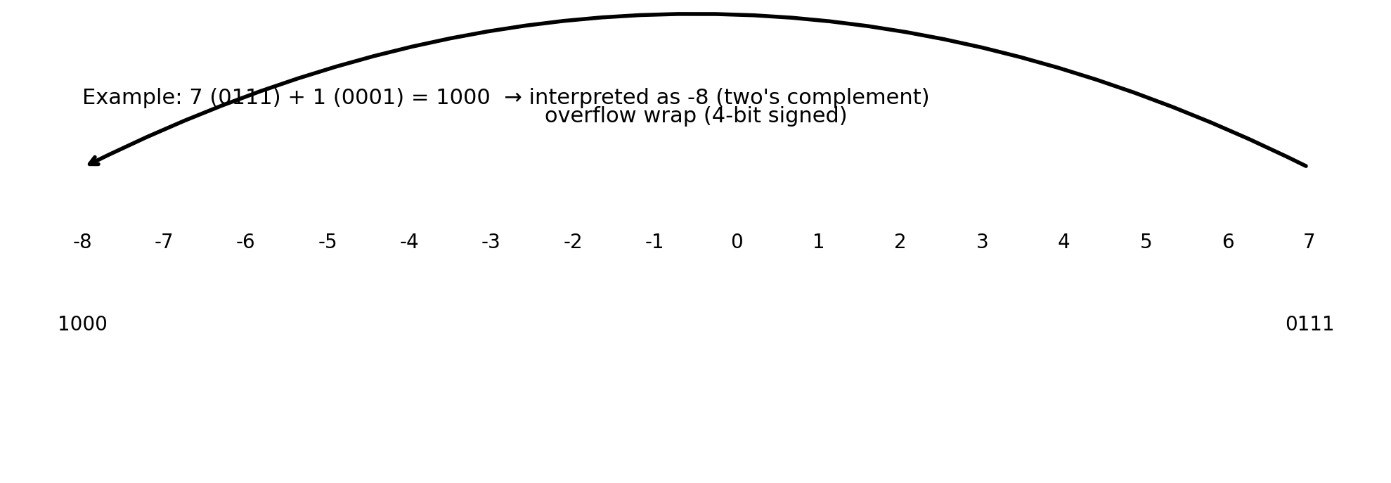
Overflow and wrap-around (visual)
Key idea: overflow is not a “math mistake” — it is a representation limit. The same bit-pattern can mean different values depending on signed/unsigned interpretation.

Slide 69
Range and Overflow
If an addition operation produces a result that exceeds the range of the number system, overflow is said to occur.
If the sum of two positive numbers yields a negative result, the sum has overflowed.
If the sum of two negative numbers yields a positive result, the sum has overflowed.
Otherwise, the sum has not overflowed.
Carryout without overflow. Sum is correct

Slide 70
Addition and Subtraction with 2’s Complement
0101 +5 0101 +5
0010 +2 1110 -2
0111 +7 10011 +3
1011 -5 1011 -5
1110 -2 0010 +2
11001 -7 1101 -3
Notes:
There are four cases of addition
Both numbers are positive
0101 +5
0010 +2
0111 +7
Both numbers are negative
1011 -5
1110 -2
1001 -7 the carry generated from the msb is discarded
One number is positive and its magnitude is larger than the negative number
0101 +5
1110 -2
0011 +3 the carry generated from the msb is discarded
One number is positive and its magnitude is smaller than the negative number
1011 -5
0010 +2
1101 -3
By using signed number based on 2’s complement the addition operation serves to add and subtract numbers.

Slide 71
Addition and Subtraction 2’s complement vs. Signed
2’s Complement Signed Binary
0101 +5 0101 +5
0010 +2 0010 +2
0111 +7 0111 +7
1011 -5 1101 -5
1110 -2 1010 -2
11001 -7 10111 -7
Notes:
Refer to the table of Signed Magnitude and 2’s complement representation of decimal values -8 to 7 discussed in the last lecture.
Compare the addition operation using 2’s complement and signed number representation.
The results for addition using 2’s complement are compatible with the decimal numbers represented in their 2’s complement form.
For example, adding +5 and +2 results in +7 all numbers are represented in their 2’s complement form.
Adding -5 and -2 results in -7, all numbers are represented in their 2’s complement form
Now compare the addition of same numbers represented in their Signed Magnitude form. The addition of +5 and +2 results in +7 all numbers are represented in their signed form.
However, adding -5 and -2 results in -7. -7 is however not represented in its signed form. In fact it represents +7.

Slide 72
Addition and Subtraction 2’complement vs. Signed
0101 +5 0101 +5
1110 -2 1010 -2
10011 +3 1111 +3
1011 -5 1101 -5
0010 +2 0010 +2
1101 -3 1111 -3
Notes:
Consider the addition of +5 and -2 or subtraction of 2 from 5. The answer is +3.
In the 2’s complement form the result 0011 (neglecting the carry bit) is compatible with 2’s complement representation of +3.
In the signed magnitude form the result 1111 doesn’t represent +3 but -7.
In the next example, adding -5 and +2 or subtracting -5 from 2 results in -3.
In the 2’s complement form the result 1101 is compatible with 2’scomplement representation of -3.
In the signed magnitude form the result 1111 doesn’t represent -3 but -7.
Thus representing signed numbers in 2’s complement form allows number to be directly added to perform addition and subtraction. The result would always be correct and in its 2’s complement form.
Thus an adder circuit is able to perform both additions and subtraction if the numbers are represented in their 2’s complement form. No subtractor circuit is required. With signed magnitude form separate adder and subtractor circuits are required or the results have to be converted into signed magnitude form.
Range of 2’s complemented numbers is more than signed magnitude representation.

Slide 73
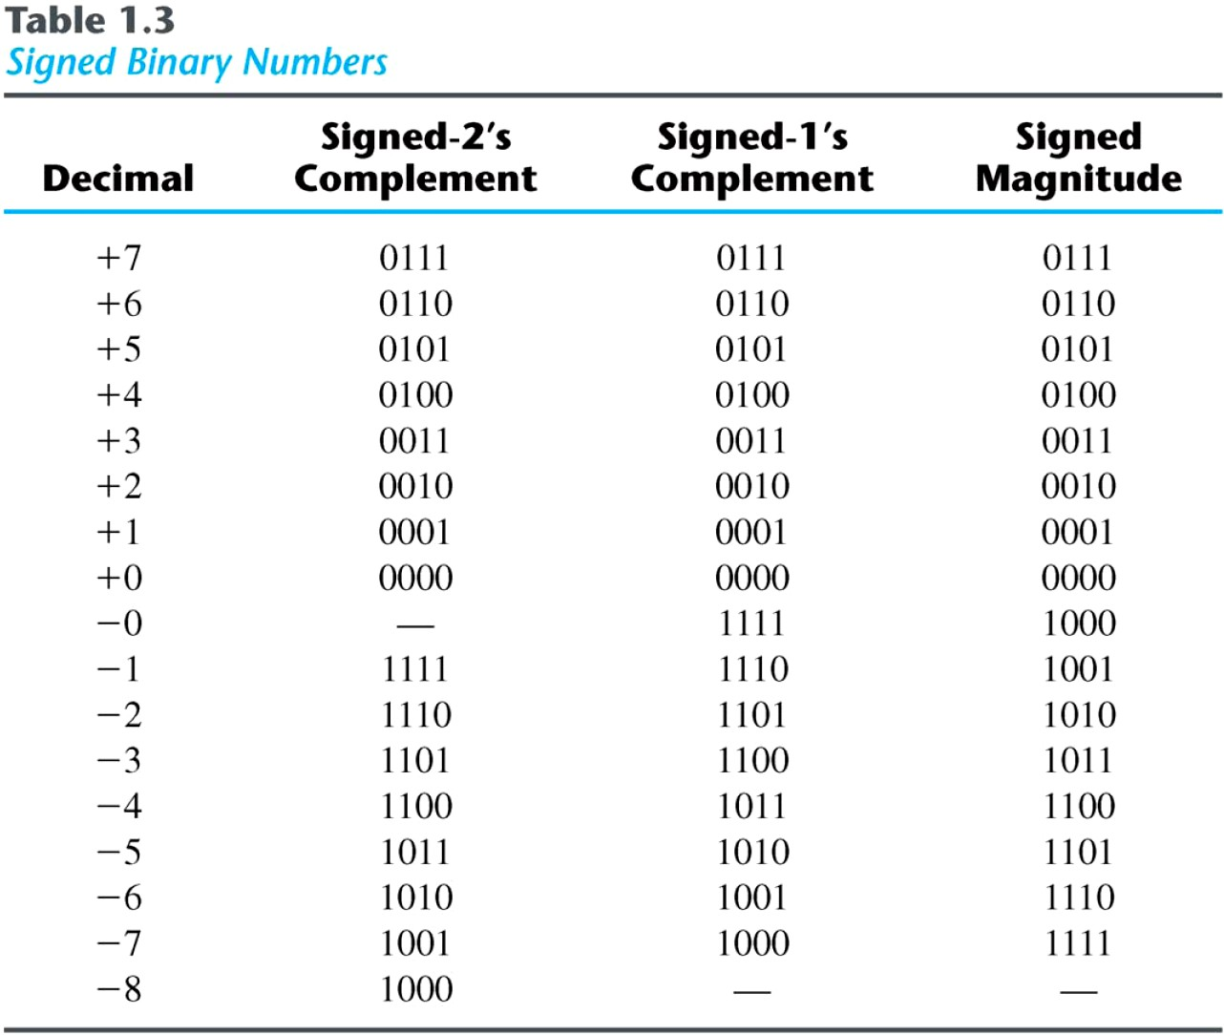
Signed Binary Numbers

Slide 74
Range and Overflow
1011 -5
1101 -3
11000 -8
1011 -5 0101 +5
1100 -4 0100 +4
10111 -9 1001 +9
Notes:
Given the choice to represent positive and negative numbers in binary
Unsigned representation is not suitable as it allows only positive numbers
Signed Magnitude allows positive and Negative numbers however addition and subtraction operations results in numbers that are not in signed magnitude form.
2’s complement allows positive and negative numbers, addition and subtraction of numbers in their 2’s complement form results in numbers that are in their 2’s complement form.
The range of 2’s complement numbers is more than signed magnitude representation.

Slide 75
Range of Signed Numbers
A certain number of bits can store only a fixed number of signed integers
Bits | Range | Total Numbers
8 | -128 to +127 | 256
16 | -32768 to +32767 | 65,536
32 | -2,147,483,648 to +2,147,483,647 | 4,294,967,296
64 | -9,223,372,036,854,775,808 to +9,223,372,036,854,775,807 | 18,446,744,073,709,551,616

Slide 76
Range of Unsigned Numbers
Total numbers in signed integers is exactly equal to the total numbers in unsigned integers in the same size of bits
Bits | Range | Total Unsigned Numbers
8 | 0 to 255 | 256
16 | 0 to 65,535 | 65,536
32 | 0 to 4,294,967,295 | 4,294,967,296
64 | 0 to 18,446,744,073,709,551,615 | 18,446,744,073,709,551,616

Slide 77


Ranges of Numbers
For a specific number of bits only a certain range of decimal numbers can be represented.
The maximum and minimum number can be found with the following relation
For unsigned numbers the range is
For Signed numbers the range is

Slide 78
Practice Problem 3
What is the number of distinct code which can be generated by
4 bit long code
6 bits long binary code
10 bits long binary code
What are the minimum number of bits required if we want to code the following number of combinations
32 combinations
100 combinations
200 combinations
450 combinations

Slide 79
Counting in Hexadecimal
Decimal | Binary | Hexadecimal | Decimal | Binary | Hexadecimal
0 | 0000 | 0 | 8 | 1000 | 8
1 | 0001 | 1 | 9 | 1001 | 9
2 | 0010 | 2 | 10 | 1010 | A
3 | 0011 | 3 | 11 | 1011 | B
4 | 0100 | 4 | 12 | 1100 | C
5 | 0101 | 5 | 13 | 1101 | D
6 | 0110 | 6 | 14 | 1110 | E
7 | 0111 | 7 | 15 | 1111 | F

Slide 80
Counting in Hexadecimal
Decimal | Hexa- Decimal | Decimal | Hexa- Decimal | Decimal | Hexa- Decimal
16 | 10 | 24 | 18 | 32 | 20
17 | 11 | 25 | 19 | 33 | 21
18 | 12 | 26 | 1A | 34 | 22
19 | 13 | 27 | 1B | 35 | 23
20 | 14 | 28 | 1C | 36 | 24
21 | 15 | 29 | 1D | 37 | 25
22 | 16 | 30 | 1E | 38 | 26
23 | 17 | 31 | 1F | 39 | 27

Slide 81
Counting in Octal
Decimal | Binary | Octal
0 | 000 | 0
1 | 001 | 1
2 | 010 | 2
3 | 011 | 3
4 | 100 | 4
5 | 101 | 5
6 | 110 | 6
7 | 111 | 7

Slide 82
Octal Addition
Carry 1
7602 2+1=3d= 3O
+ 5771 0+7=7d= 7O
15573 6+7=13d= 15O
1+7+5=13d =15O

Slide 83
Octal Subtraction
Borrow 11
7602 2-1=1d 1O
- 5771 8-7=1d 1O
1611 13-7=6d 6O
6-5=1d 1O

Slide 84
Hexadecimal Addition
Carry 1
2AC6 6+5=11d Bh
+ 92B5 C+B=23d 17h
BD7B A+2+1=13d Dh
2+9=11d Bh

Slide 85
Hexadecimal Subtraction
Borrow 111
92B5 21-6=15d = Fh
- 2AC6 26-C=14d = Eh
67EF 17-A=7d = 7h
8-2=6d = 6h

Slide 86
Integer Storage System (1/2)
Byte is the basic storage unit in x86 architecture
Byte is composed of 8 bits
Byte
8
Word
16
Doubleword
32
Quadword
64

Slide 87
Integer Storage System (2/2)
Some larger measurements units
One kilobyte = 2¹⁰ bytes = 1024 bytes
One megabyte = 2²⁰ bytes = 1,048,576 bytes
One gigabyte = 2³⁰ bytes = 1,073,741,824 bytes
One terabyte = 2⁴⁰ bytes = 1,099,511,627,776 bytes
One petabyte = 2⁵⁰ bytes = 2⁴⁰ kilobytes
One exabyte = 2⁶⁰ bytes = 2¹⁰ petabytes
One zettabyte = 2⁷⁰ bytes = 2³⁰ terabytes
One yottabyte = 2⁸⁰ bytes = 2²⁰ exabytes

Slide 88
Alternate Representations
BCD Code
Gray Code

Slide 89
Binary Coded Decimal (BCD)
The BCD code is the 8,4,2,1 code.
8, 4, 2, and 1 are weights
BCD is a weighted code
This code is the simplest, most intuitive binary code for decimal digits and uses the same powers of 2 as a binary number, but only encodes the first ten values from 0 to 9.
Example: 0110 (6) = 0110 (6)
1010 (10) = 0001 (1) + 0000 (0)
How many “invalid” code words are there?
What are the “invalid” code words?
Chapter 1

Slide 90
Alternate Representations
BCD (Binary Coded Decimal) Code
Decimal | BCD | Decimal | BCD
0 | 0000 | 5 | 0101
1 | 0001 | 6 | 0110
2 | 0010 | 7 | 0111
3 | 0011 | 8 | 1000
4 | 0100 | 9 | 1001
Notes:
Most digital systems display a count value or the time in decimal on 7-segment LED display panels.
Older model Calculator had LED displays instead of the LCD displays.
Since the numbers displayed are in decimal, therefore the binary code used to display the decimal numbers is designed to represent a single digit.
Consider a 2-digit 7-segment display that can display a count value from 0 to 99. To display the two decimal digits two separate binary codes are applied at the 7-segment display circuit inputs. Since each binary code has to specify a digit between 0 and 9 therefore only 10 different binary codes are required.
How many binary bits are required to represent 10 unique codes?
A 4-bit binary code allows 16 different binary combinations to be represented. Only the first 10, 4-bit binary codes are used, the remaining 6 codes are not used.
Thus displaying a 2-digit decimal number 79 would require the digital system to generate two BCD numbers 0111 and 1001 respectively

Slide 91
Warning: Conversion or Coding?
Do NOT mix up conversion of a decimal number to a binary number with coding a decimal number with a BINARY CODE.
13₁₀ = 1101₂ (This is conversion)
13 ⇔ 0001|0011 (This is coding)
Chapter 1
6

Slide 92
BCD Arithmetic
Given a BCD code, we use binary arithmetic to add the digits:
8 | 1000 | Eight
+5 | +0101 | Plus 5
13 | 1101 | is 13 (> 9)
Note that the result is MORE THAN 9, so must be represented by two digits!
To correct the digit, add 6:
8 | 1000 | Eight
+5 | +0101 | Plus 5
13 | 1101 | is 13 (> 9)
 | +0110 | so add 6
 | carry = 1 0011 0001 | 0011 | leaving 3 + cy Final answer (two digits)
Chapter 1
7

Slide 93

BCD Addition Example
Add 1897BCD to 2905BCD showing carries and digit corrections.
0001 | 1000 | 1001 | 0111
+ 0010 | 1001 | 0000 | 0101
0100 | ¹ 0010 | 1010 | 1100
 | +0110 | +0110 | +0110
= 0100 | 1000 | 0000 | 0010
Chapter 1
8

Slide 94
Gray Code (RBC) Reflected Binary Code)
Binary Code more than 1 bit change
Electromechanical applications of digital systems restrict bit change to 1
Shaft encoders
Braking Systems
Un-Weighted Code

Slide 95
Gray Code
Decimal | Gray | Binary
0 | 0000 | 0000
1 | 0001 | 0001
2 | 0011 | 0010
3 | 0010 | 0011
4 | 0110 | 0100
5 | 0111 | 0101
6 | 0101 | 0110
7 | 0100 | 0111

Slide 96
Gray Code Application
Notes:
The Diagram shows a disk connected to the shaft of a rotating machine.
The shaded areas on the disk indicate conducting area at a voltage of +5 volts.
The non-shaded area indicate a non-conducting area.
Three stationary brushes A, B and C touch the surface of the rotating disk.
The three brushes are connected to three LED lamps through wires.
As the disk rotates the brushes come in contact with the conducting area and the insulated area. The three LEDs display the position of the rotating shaft in terms of 3-bit numbers.
Thus if the disk on the left rotates in the anti-clockwise direction by 45⁰ the Brush A comes in contact with the conducting strip at 5 volts, which turns on the LED indicating Binary 001.
If the disk continuous its rotation, after a rotation of another 45⁰ ,brush B comes in contact with the conducting strip and brush A comes in contact with the non-conducting strip. Thus LED connected to brush B lights up indicating binary 010.
Thus at any instant of time, the LEDs indicate the angular position of the rotating shaft.
Assume that the three brushes A, B and C are not aligned properly and Brush B is slightly ahead of brushes A and C.
Now if the disk rotates 90⁰ from its start position. Brush A would be in contact with the conducting strip, Brush B due to its misalignment would also be in contact with the conducting strip and brush C would be in contact with the insulated strip.
Thus when the disk rotates the LEDs will show a 001,followed by a 011 for a short duration when the disk rotates from 90⁰ to 91⁰ and then to 010.
Thus due to misalignment the count value jumped from 1 to 3 and then back to 2.
Consider the disk shown on the right. The conducting and non-conducting strips follow a Gray Code pattern 000, 001, 011, 010, 110, 111, 101 and 100 representing decimal 0, 1, 2, 3, 4, 5, 6 and 7.
Now even if the brushes are misaligned, the LEDs would always display the correct count value.

Slide 97
DECIMAL CODES - Binary Codes for Decimal Digits
There are over 8,000 ways that you can write 10 elements using binary numbers of 4 bits. Some of the common codes are given in table.
Decimal | 8,4,2,1 | Excess3
0 | 0000 | 0011
1 | 0001 | 0100
2 | 0010 | 0101
3 | 0011 | 0110
4 | 0100 | 0111
5 | 0101 | 1000
6 | 0110 | 1001
7 | 0111 | 1010
8 | 1000 | 1011
9 | 1001 | 1100
Chapter 1

Slide 98
Alphanumeric Code
Numbers, Characters, Symbols
ASCII 7-bit Code
American Standard Code for Information Interchange
10 Numbers (0-9)
26 Lower Case Characters (a-z)
26 Upper Case Characters (A-Z)
Punctuation and Symbols
32 Control Characters

Slide 99
ASCII Code
Numbers 0 to 9
ASCII 0110000 (30h) to 0111001 (39h)
Alphabets a to z
ASCII 1100001 (61h) to 1111010 (7Ah)
Alphabets A to Z
ASCII 1000001 (41h) to 1011010 (5Ah)
Control Characters
ASCII 0000000 (0h) to 0011111 (1Fh)

Slide 100
Alphanumeric Code
Extended ASCII 8-bit Code
Additional 128 Graphic characters
Unicode 16-bit Code

Slide 101
Error Detection
Digital Systems are very Reliable
Errors during storage or transmission
Parity Bit
Even Parity
Odd Parity

Slide 102
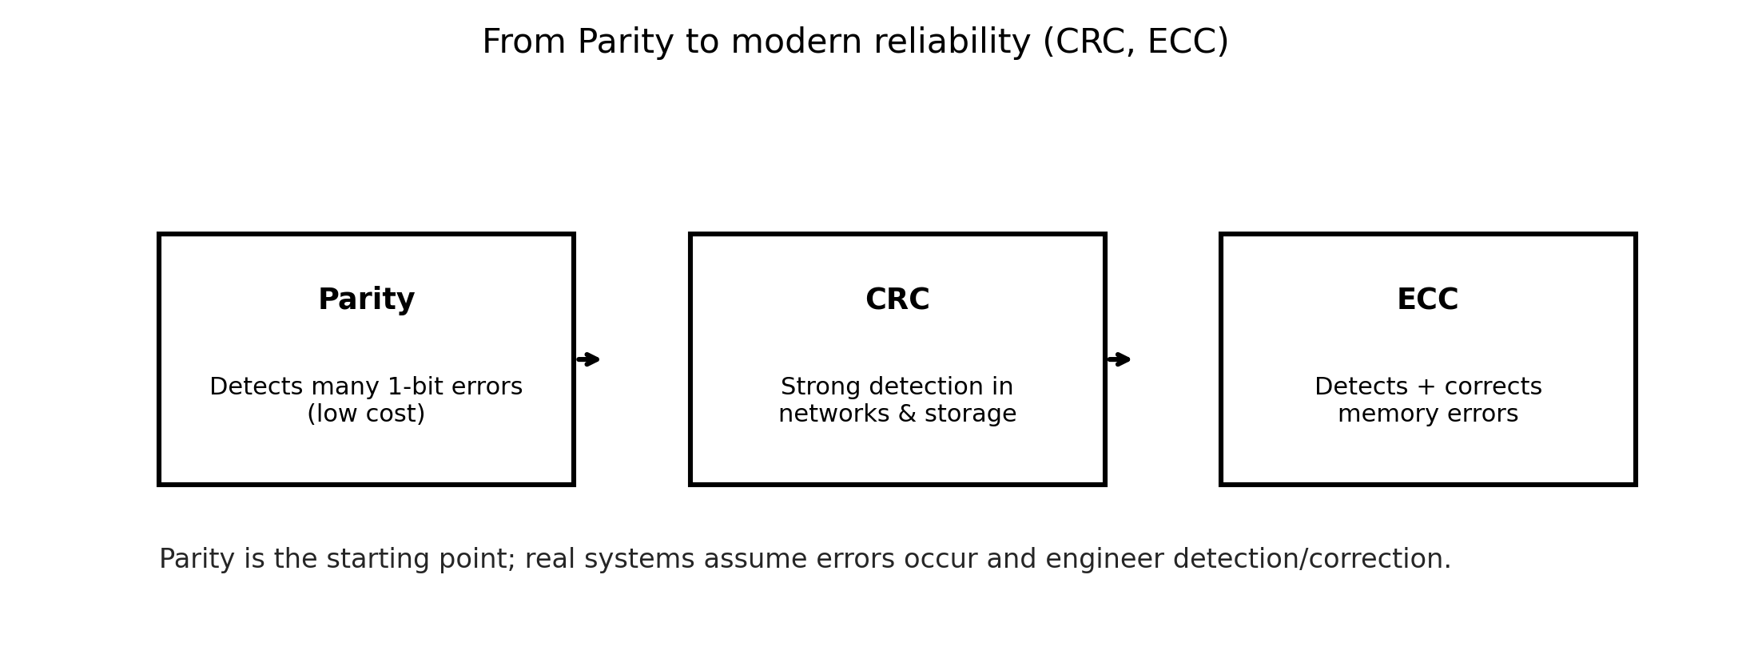
From parity to CRC and ECC (industry bridge)
Parity is a starting point
CRC is common in networks/storage
ECC is common in memory systems

Slide 103
PARITY BIT Error-Detection Codes
To detect errors in data communication and processing, an additional bit is sometimes added to a binary code word to define its parity.
A parity bit is the extra bit included to make the total number of 1s in the resulting code word either even or odd.
Parity can detect all single-bit errors and some multiple-bit errors.
A code word has even parity if the number of 1’s in the code word is even.
A code word has odd parity if the number of 1’s in the code word is odd.
Chapter 1

Slide 104
4-Bit Parity Code Example
Fill in the even and odd parity bits:
Even Parity Message - Parity |  | Odd Parity Message ₋ Parity
000 | - | 000 | -
001 | - | 001 | -
010 | - | 010 | -
011 | - | 011 | -
100 | - | 100 | -
101 | - | 101 | -
110 | - | 110 | -
111 | - | 111 | -
The codeword "1111" has even parity and the codeword "1110" has odd parity. Both can be used to represent 3-bit data.
Chapter 1

Slide 105
Odd Parity Error Detection
Original data 10011010
With Odd Parity 110011010
1-bit error 110111010
Number of 1s even indicates 1-bit error
2-bit error 110110010
Number of 1s odd no error indicated
3-bit error 100110010
Number of 1s even indicates error

